Slide 1
CSC 112: Computer Operating Systems Lecture 17 Demand Paging (Finished), General I/O, Storage Devices
Department of Computer Science,
Hofstra University
Acknowledgement: Lecture slides based on UC Berkeley CS 162: Operating Systems and System Programming

Slide 2
Recall: Demand Paging Cost Model
Since Demand Paging like caching, can compute average access time! (“Effective Access Time”)
EAT = Hit Rate x Hit Time + Miss Rate x Miss Time
EAT = Hit Time + Miss Rate x Miss Penalty
Example:
Memory access time = 200 nanoseconds
Average page-fault service time = 8 milliseconds
Suppose p = Probability of miss, 1-p = Probably of hit
Then, we can compute EAT as follows:
EAT = 200ns + p x 8 ms
= 200ns + p x 8,000,000ns
If one access out of 1,000 causes a page fault, then EAT = 8.2 μs:
This is a slowdown by a factor of 40!
What if want slowdown by less than 10%?
EAT < 200ns x 1.1 ⇒ p < 2.5 x 10⁻⁶
This is about 1 page fault in 400,000!

Slide 3
Recall: Clock Algorithm (Not Recently Used)
Set of all pages
in Memory
Single Clock Hand:
Advances only on page fault!
Check for pages not used recently
Mark pages as not used recently
Clock Algorithm: Arrange physical pages in circle with single clock hand
Approximate LRU (approximation to approximation to MIN)
Replace an old page, not the oldest page
Details:
Hardware “use” bit per physical page (called “accessed” in Intel architecture):
Hardware sets use bit on each reference
If use bit isn’t set, means not referenced in a long time
Some hardware sets use bit in the TLB; must be copied back to page TLB entry gets replaced
On page fault:
Advance clock hand (not real time)
Check use bit: 1→ used recently; clear and leave alone 0→ selected candidate for replacement

Slide 4
Recall: Meaning of PTE bits
Which bits of a PTE entry are useful to us for the Clock Algorithm? Remember Intel PTE:
The “Present” bit (called “Valid” elsewhere):
P==0: Page is invalid and a reference will cause page fault
P==1: Page frame number is valid and MMU is allowed to proceed with translation
The “Writable” bit (could have opposite sense and be called “Read-only”):
W==0: Page is read-only and cannot be written.
W==1: Page can be written
The “Accessed” bit (called “Use” elsewhere):
A==0: Page has not been accessed (or used) since last time software set A→0
A==1: Page has been accessed (or used) since last time software set A→0
The “Dirty” bit (called “Modified” elsewhere):
D==0: Page has not been modified (written) since PTE was loaded
D==1: Page has changed since PTE was loaded
PTE:
Page Frame Number
(Physical Page Number)
Free
(OS)
0
PS
D
A
PCD
PWT
U
W
P
31-12
11-9
8
7
6
5
4
3
2
1
0

Slide 5
Recall: Second-Chance List Algorithm (VAX/VMS)
LRU victim
Directly
Mapped Pages
Marked: RW
List: FIFO
Overflow
Second
Chance List
Marked: Invalid
List: LRU
Access
Page-in
From disk
New
Active Pages
New
SC Victims
Split memory in two: Active list (RW), SC list (Invalid)
Access pages in Active list at full speed
Otherwise, Page Fault
Always move overflow page from end of Active list to front of Second-chance list (SC) and mark invalid
Desired Page On SC List: move to front of Active list, mark RW
Not on SC list: page in to front of Active list, mark RW; page out LRU victim at end of SC list

Slide 6
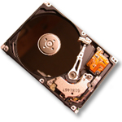
Free List
Set of all pages
in Memory
Single Clock Hand: Advances as needed to keep freelist full (“background”)
D
D
Free Pages
For Processes
Keep set of free pages ready for use in demand paging
Freelist filled in background by Clock algorithm or other technique (“Pageout demon”)
Dirty pages start copying back to disk when enter list
Like VAX second-chance list
If page needed before reused, just return to active set
Advantage: faster for page fault
Can always use page (or pages) immediately on fault

Slide 7
Reverse Page Mapping (Sometimes called “Coremap”)
When evicting a page frame, how to know which PTEs to invalidate?
Hard in the presence of shared pages (forked processes, shared memory, …)
Reverse mapping mechanism must be very fast
Must hunt down all page tables pointing at given page frame when freeing a page
Must hunt down all PTEs when seeing if pages “active”
Implementation options:
For every page descriptor, keep linked list of page table entries that point to it
Management nightmare – expensive
Linux: Object-based reverse mapping
Link together memory region descriptors instead (much coarser granularity)

Slide 10
Allocation of Page Frames (Memory Pages)
How do we allocate memory among different processes?
Does every process get the same fraction of memory? Different fractions?
Should we completely swap some processes out of memory?
Each process needs minimum number of pages
Want to make sure that all processes that are loaded into memory can make forward progress
Possible Replacement Scopes:
Global replacement – process selects replacement frame from set of all frames; one process can take a frame from another
Local replacement – each process selects from only its own set of allocated frames

Slide 11
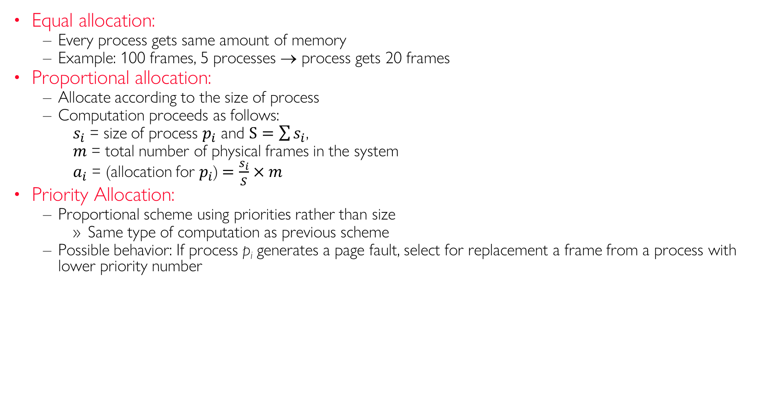
Fixed/Priority Allocation
Equal allocation:
Every process gets same amount of memory
Example: 100 frames, 5 processes → process gets 20 frames
Proportional allocation:
Allocate according to the size of process
Computation proceeds as follows:
$s_{i}$ = size of process $p_{i}$ and $S=\sum{s_{i}}$,
$m$ = total number of physical frames in the system
$a_{i}$ = (allocation for $p_{i}$)$=\frac{s_{i}}{S}×m$
Priority Allocation:
Proportional scheme using priorities rather than size
Same type of computation as previous scheme
Possible behavior: If process p_{i} generates a page fault, select for replacement a frame from a process with lower priority number
Notes:
(Fixed Scheme)
(Fixed Scheme)

Slide 12
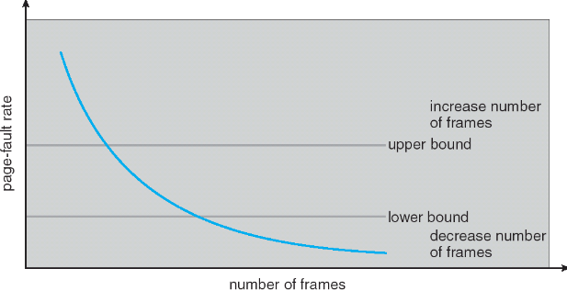
Page-Fault Frequency Allocation
An adaptive scheme
Can we reduce Capacity misses by dynamically changing the number of pages/application?
Establish “acceptable” page-fault rate
If actual rate too low, process loses frames (physical pages)
If actual rate too high, process gains frames
Question: What if we just don’t have enough memory?
Notes:
What if some application just needs more memory?

Slide 13
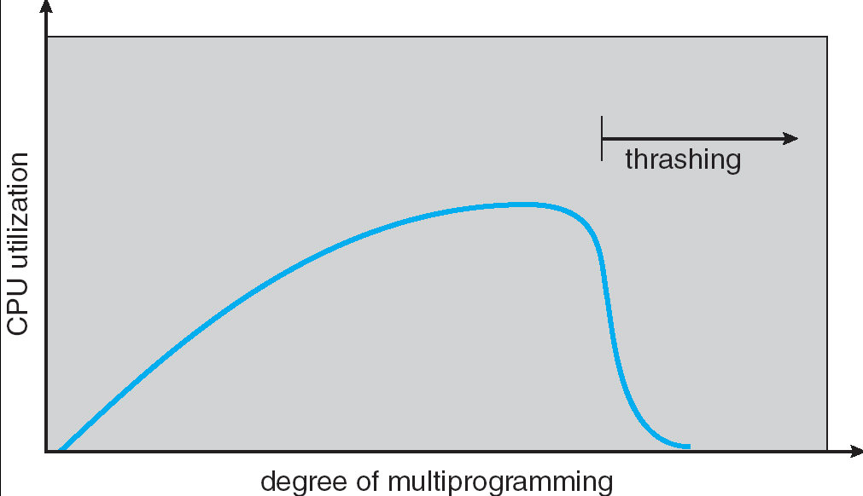
Thrashing
If a process does not have “enough” pages, the page-fault rate is very high. This leads to:
low CPU utilization
OS spends most of its time swapping to disk
Thrashing: a process is busy swapping pages in and out with little or no actual progress
Example: one program, touches 50 pages (each equally likely). Have only 40 physical page frames. Assume memory reference cost is 200 ns/ref. Assume every 5th page reference causes a page fault:
Total cost of 5 refs = 4 refs x 200 ns + 1 page fault x 10 ms for disk I/O = 800 ns + 10 ms = 10.0008 ms
Approximately 2 ms/ref (Factor of slow down 2ms/200ns=10,000))
Notes:
Example: one program, touches 50 pages (each equally likely). Have only 40 physical page frames.
How bad is this?
- Does your program run at 80% speed?
- Does your program run at 20% speed?
Performance is really bad
If we have enough pages, 200 ns/ref, but if too few pages, assume every 5th page reference causes a page fault not 100 MIPS, but 500 IPS!
= 4 refs x 200 ns
1 page fault x 10 ms for disk I/O
= 5 refs, 10 ms + 800 ns => 2 ms/ref (not 100 MIPS, but 500 IPS! Factor of 10,000)
Machine appears to have stopped!

Slide 14
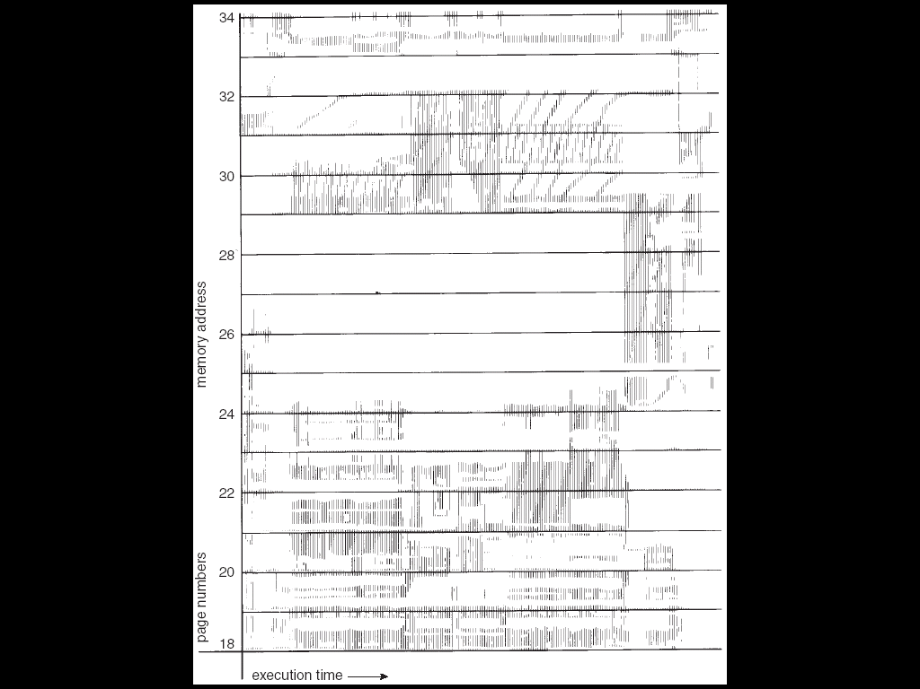
Locality In A Memory-Reference Pattern
Program Memory Access Patterns have temporal and spatial locality
Group of Pages accessed along a given time slice called the “Working Set”
Working Set defines minimum number of pages for process to behave well
Not enough memory for Working Set ⇒ Thrashing
Better to swap out process?
Notes:
Questions:
How do we detect Thrashing?
What is best response to Thrashing?

Slide 15
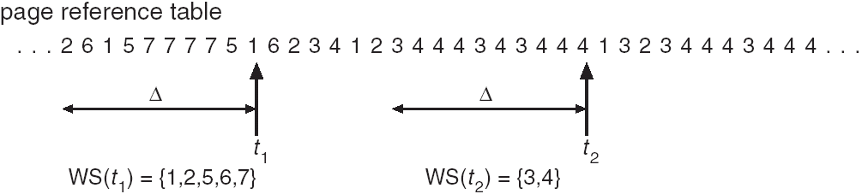
Working-Set Model
Δ ≡ working-set window ≡ fixed number of page references
Example: 10,000 instructions
WSi (working set of Process Pi) = total set of pages referenced in the most recent Δ (varies in time)
if Δ too small will not encompass entire locality
if Δ too large will encompass several localities
if Δ = ∞ ⇒ will encompass entire program
D = Σ|WSi| ≡ total demand frames
if D > m ⇒ Thrashing
Policy: if D > m, then suspend/swap out processes
This can improve overall system behavior by a lot!

Slide 16
What about Compulsory Misses?
Recall that compulsory misses are misses that occur the first time that a page is seen
Pages that are touched for the first time
Pages that are touched after process is swapped out/swapped back in
Clustering:
On a page-fault, bring in multiple pages “around” the faulting page to take advantage of spatial locality
Since efficiency of disk reads increases with sequential reads, makes sense to read several sequential pages
Working Set Tracking:
Use algorithm to try to track working set of application
When swapping process back in, swap in working set
Notes:
Memory management in Linux considerably more complex than the examples we have been discussing
Memory Zones: physical memory categories
ZONE_DMA: < 16MB memory, DMAable on ISA bus
ZONE_NORMAL: 16MB → 896MB (mapped at 0xC0000000)
ZONE_HIGHMEM: Everything else (> 896MB)
Each zone has 1 freelist, 2 LRU lists (Active/Inactive)
Many different types of allocation
SLAB allocators, per-page allocators, mapped/unmapped
Many different types of allocated memory:
Anonymous memory (not backed by a file, heap/stack)
Mapped memory (backed by a file)
Allocation priorities
Is blocking allowed/etc

Slide 17
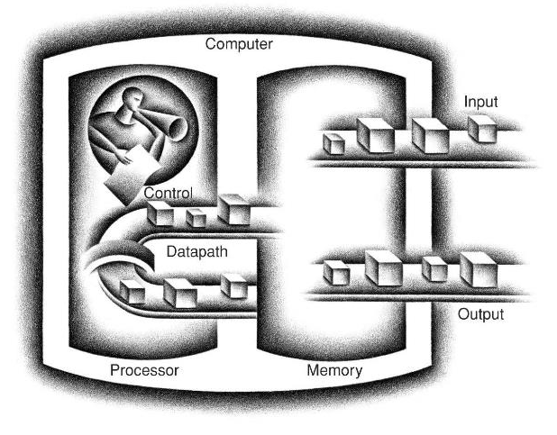
Recall: Five Components of a Computer
Diagram from “Computer Organization and Design” by Patterson and Hennessy

Slide 18
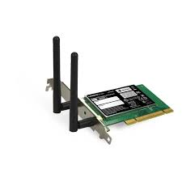


Requirements of I/O
OS provides common services in form of I/O
Without I/O, computers are useless (disembodied brains?)
But… thousands of devices, each slightly different
How can we standardize the interfaces to these devices?
Devices unreliable: media failures and transmission errors
How can we make them reliable???
Devices unpredictable and/or slow
How can we manage them if we don’t know what they will do or how they will perform?
Process 1
Process 2
Process 3
Software
OS Hardware Virtualization
Hardware
ISA
Memory
Processor
Protection Boundary
OS Memory
Ctrlr
Networks
Displays
Storage
Inputs
Notes:
So far in CS 162, we have studied:
Abstractions: the APIs provided by the OS to applications running in a process
Synchronization/Scheduling: How to manage the CPU
What about I/O?

Slide 19
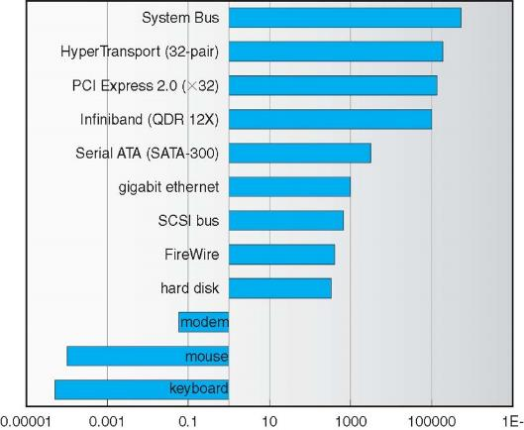
Example: Device Transfer Rates in Mb/s (Sun Enterprise 6000)
Device data rates vary over 12 orders of magnitude!!!
System must be able to handle this wide range
not have high overhead/byte for fast devices
not waste time waiting for slow devices

Slide 20

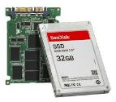
In a Picture
Read / Write
wires
Processor
I/O
Controllers
Secondary Storage (Disk)
Core
L2 Cache
Registers
L1 Cache
interrupts
Secondary Storage (SSD)
Main
Memory
(DRAM)
Read / Write
DMA transfer
L3 Cache (shared)
Core
L2 Cache
Registers
L1 Cache
I/O devices are supported by I/O Controllers
Processors accesses them by reading and writing IO registers as if they were memory
Write commands and arguments, read status and results

Slide 21
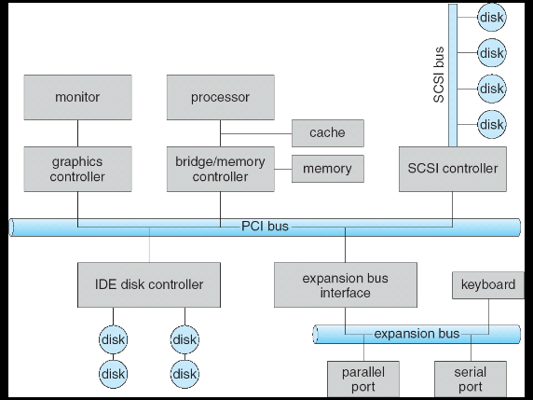
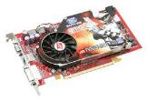
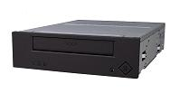



Modern I/O Systems
network

Slide 22
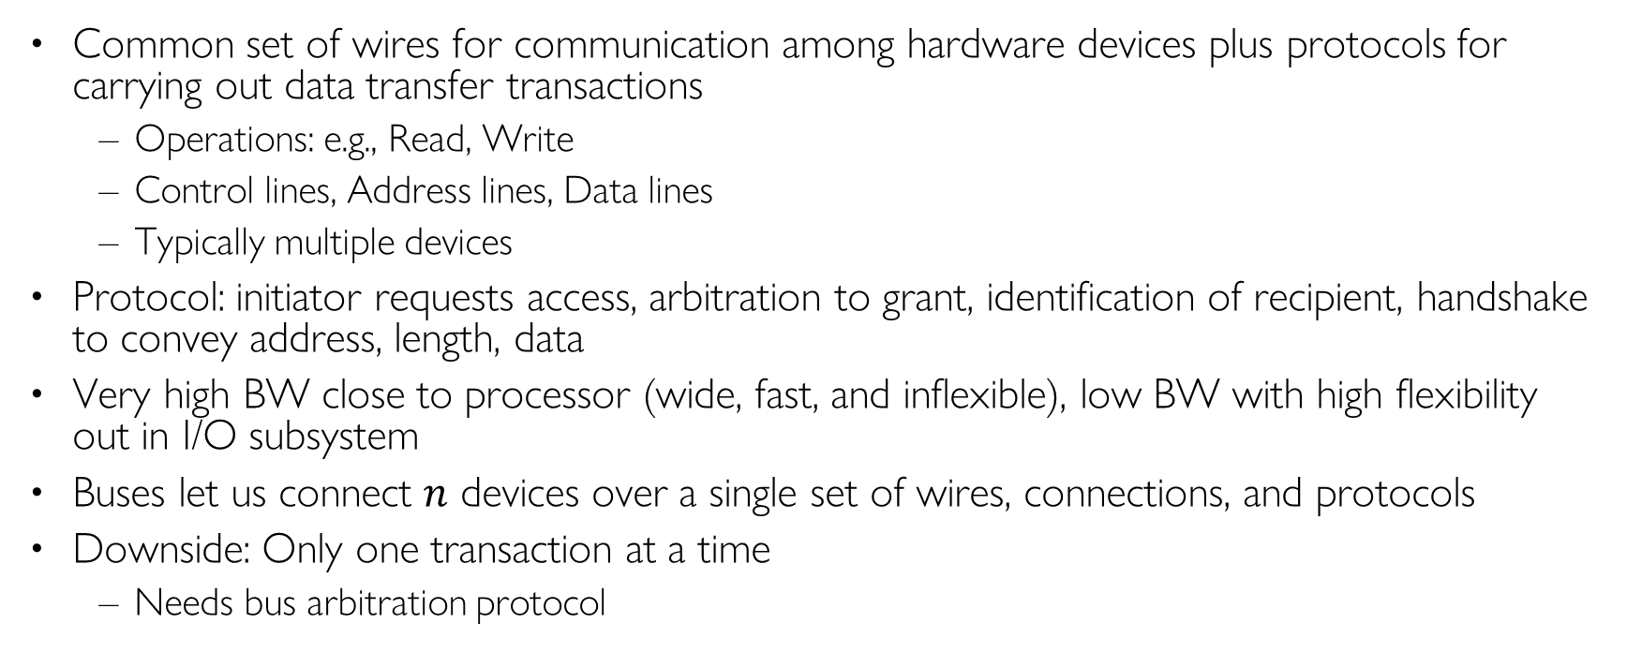
What’s a bus?
Common set of wires for communication among hardware devices plus protocols for carrying out data transfer transactions
Operations: e.g., Read, Write
Control lines, Address lines, Data lines
Typically multiple devices
Protocol: initiator requests access, arbitration to grant, identification of recipient, handshake to convey address, length, data
Very high BW close to processor (wide, fast, and inflexible), low BW with high flexibility out in I/O subsystem
Buses let us connect $n$ devices over a single set of wires, connections, and protocols
Downside: Only one transaction at a time
Needs bus arbitration protocol
Notes:
$O\left(n^{2}\right)$ relationships with 1 set of wires (!)

Slide 23
Example: PCI Architecture
RAM
Memory
Bus
CPU
Host Bridge
PCI #0
ISA Bridge
PCI Bridge
PCI #1
ISA Controller
PCI Slots
USB Controller
SATA Controller
Scanner
Legacy Devices
Root Hub
Hard Disk
DVD ROM
Hub
Webcam
Mouse
Keyboard
Notes:
PCI started life out as a bus
But a parallel bus has many limitations
Multiplexing address/data for many requests
Slowest devices must be able to tell what’s happening (e.g., for arbitration)
Bus speed is set to that of the slowest device
No longer a parallel bus
Really a collection of fast serial channels or “lanes”
Devices can use as many as they need to achieve a desired bandwidth
Slow devices don’t have to share with fast ones
One of the successes of device abstraction in Linux was the ability to migrate from PCI to PCI Express
The physical interconnect changed completely, but the old API still worked

Slide 24
How does the Processor Talk to the Device?
Processor Memory Bus
Regular
Memory
CPU
Bus
Adaptor
Bus
Adaptor
Device
Controller
Address +
Data
Other Devices
or Buses
Bus
Interface
Hardware
Controller
Interrupt
Controller
Interrupt Request
read
Addressable
Memory
and/or
Queues
write
control
CPU interacts with a Controller
Contains a set of registers that can be read and written
May contain memory for request queues, etc.
Processor accesses registers in two ways:
Port-Mapped I/O: in/out instructions to read/write I/O ports
Memory-mapped I/O: load/store instructions
Registers/memory appear in physical address space
I/O accomplished with load and store instructions
status
Registers
(port 0x20)
Memory Mapped
Region: 0x8f008020
Notes:
Example from the Intel architecture: out 0x21,AL

Slide 25
Example: Memory-Mapped Display Controller
Memory-Mapped:
Hardware maps control registers and display memory into physical address space
Addresses set by HW jumpers or at boot time
Simply writing to display memory (also called the “frame buffer”) changes image on screen
Addr: 0x8000F000 — 0x8000FFFF
Writing to Graphics Command Queue, e.g., enter a set of triangles describing some scene
Addr: 0x80010000 — 0x8001FFFF
Writing to the command register may cause on-board graphics hardware to do something, e.g., render the above scene
Addr: 0x0007F004
Can protect with address translation with page tables
0x80020000
Graphics
Command
Queue
0x80010000
Display
Memory
0x8000F000
0x0007F004
Command
0x0007F000
Status
Physical
Address
Space
Notes:
graphics description

Slide 26
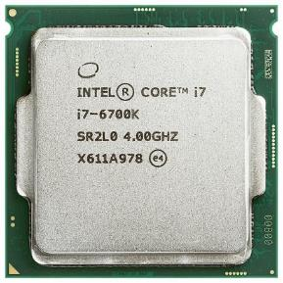
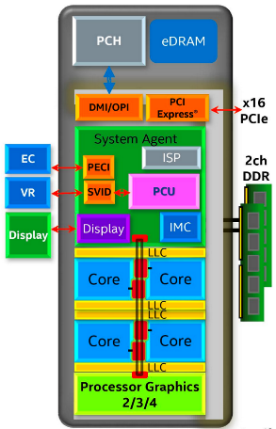
Chip-scale Features of 2015 x86 (Sky Lake)
Significant pieces:
Four OOO cores with deeper buffers
Intel MPX (Memory Protection Extensions)
Intel SGX (Software Guard Extensions)
Issue up to 6 μ-ops/cycle
GPU, System Agent (Mem, Fast I/O)
Large shared L3 cache with on-chip ring bus
2 MB/core instead of 1.5 MB/core
High-BW access to L3 Cache
Integrated I/O
Integrated memory controller (IMC)
Two independent channels of DRAM
High-speed PCI-Express (for Graphics cards)
Direct Media Interface (DMI) Connection to PCH (Platform Control Hub)
Notes:
Let’s look at I/O in a modern processor.

Slide 27
Operational Parameters for I/O
Data granularity: Byte vs. Block
Some devices provide single byte at a time (e.g., keyboard)
Others provide large blocks (e.g., disks, networks, etc.)
Access pattern: Sequential vs. Random
Some devices must be accessed sequentially (e.g., tape)
Others can be accessed “randomly” (e.g., disk, SSD)
Fixed overhead to start transfers
Some devices require continual monitoring
Others generate interrupts when they need service
Transfer Mechanism: Programmed IO and DMA

Slide 28
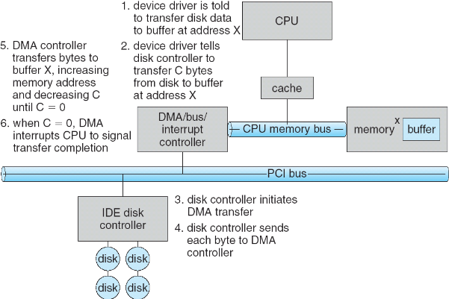
Transferring Data To/From Controller
Programmed I/O:
Each byte transferred via processor in/out or load/store
Pro: Simple hardware, easy to program
Con: Consumes processor cycles proportional to data size
Direct Memory Access:
Give controller access to memory bus
Ask it to transfer data blocks to/from memory directly
Sample interaction with DMA controller (from OSC book):
1
2
3

Slide 29
Transferring Data To/From Controller
Programmed I/O:
Each byte transferred via processor in/out or load/store
Pro: Simple hardware, easy to program
Con: Consumes processor cycles proportional to data size
Direct Memory Access:
Give controller access to memory bus
Ask it to transfer data blocks to/from memory directly
Sample interaction with DMA controller (from OSC book):
6
5
4

Slide 30
I/O Device Notifying the OS
The OS needs to know when:
The I/O device has completed an operation
The I/O operation has encountered an error
I/O Interrupt:
Device generates an interrupt whenever it needs service
Pro: handles unpredictable events well
Con: interrupts relatively high overhead
Polling:
OS periodically checks a device-specific status register
I/O device puts completion information in status register
Pro: low overhead
Con: may waste many cycles on polling if infrequent or unpredictable I/O operations
Actual devices combine both polling and interrupts
For instance – High-bandwidth network adapter:
Interrupt for first incoming packet
Poll for following packets until hardware queues are empty
Notes:
After the OS has issued a command to the I/O device either via a special I/O instruction or by writing to a location in the I/O address space, the OS needs to be notified when:
(a) The I/O device has completed the operation.
(b) Or when the I/O device has encountered an error.
This can be accomplished in two different ways: Polling and I/O interrupt.
+1 = 58 min. (Y:38)

Slide 31

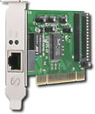
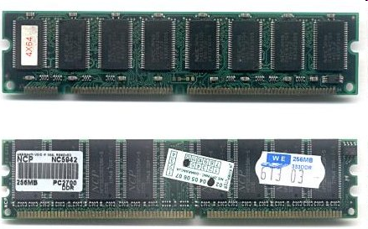
Kernel Device Structure
The System Call Interface
Process
Management
Memory Management
Filesystems
Device Control
Networking
Concurrency, multitasking
Virtual memory
Files and dirs: the VFS
TTYs and device access
Connectivity
Architecture
Dependent
Code
Memory Manager
File System Types
Device Control
Network Subsystem
Block Devices
IF drivers

Slide 32
Recall: Device Drivers
Device Driver: Device-specific code in the kernel that interacts directly with the device hardware
Supports a standard, internal interface
Same kernel I/O system can interact easily with different device drivers
Special device-specific configuration supported with the ioctl() system call
Device Drivers typically divided into two pieces:
Top half: accessed in call path from system calls
implements a set of standard, cross-device calls like open(), close(), read(), write(), ioctl(), strategy()
This is the kernel’s interface to the device driver
Top half will start I/O to device, may put thread to sleep until finished
Bottom half: run as interrupt routine
Gets input or transfers next block of output
May wake sleeping threads if I/O now complete

Slide 33
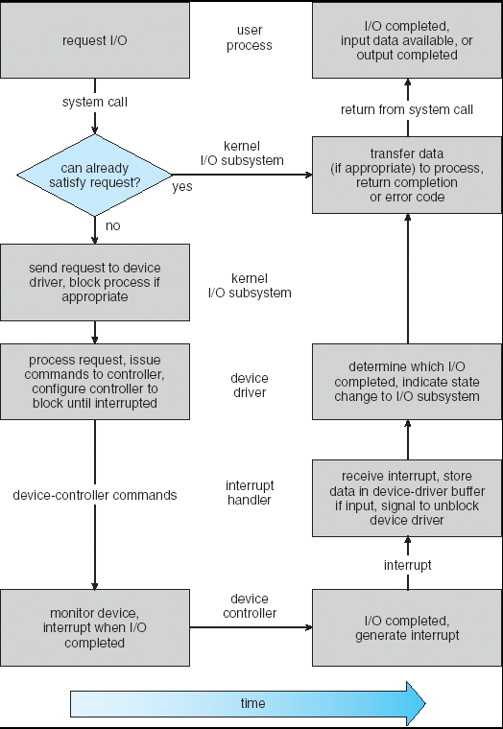
Recall: Life Cycle of An I/O Request
User
Program
Kernel I/O
Subsystem
Device Driver
Top Half
Device Driver
Bottom Half
Device
Hardware

Slide 34
Conclusion
I/O Devices Types:
Many different speeds (0.1 bytes/sec to GBytes/sec)
Different Access Patterns:
Block Devices, Character Devices, Network Devices
Different Access Timing:
Blocking, Non-blocking, Asynchronous
I/O Controllers: Hardware that controls actual device
Processor Accesses through I/O instructions, load/store to special physical memory
Notification mechanisms
Interrupts
Polling: Report results through status register that processor looks at periodically
Device drivers interface to I/O devices
Provide clean Read/Write interface to OS above
Manipulate devices through PIO, DMA & interrupt handling
Three types: block, character, and network

